Slide 1
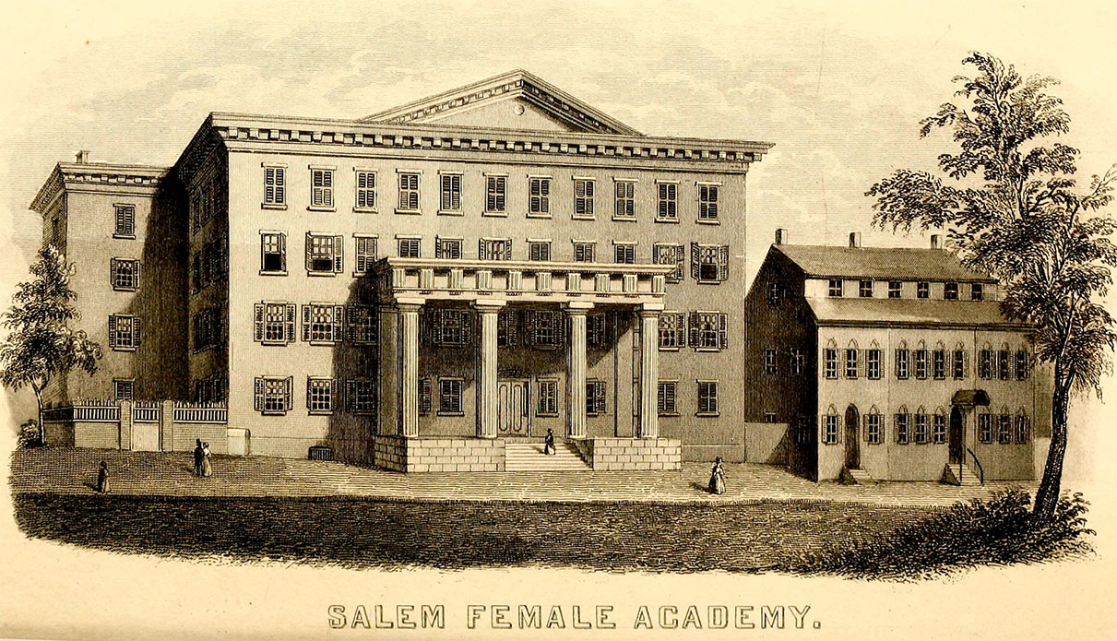
Salem Female Academy and the Transition from Slavery to Segregation during Reconstruction
“Salem Female Academy,” North Carolina Room, Forsyth County Public Library Postcard Collection
Jessi Bowman
HIST 310: Clio Colloquium
Salem College
April 24, 2018

Slide 2
Emancipation in Salem, the reading of General Orders No. 32. Pencil graphite drawing by Leo Rucker. Courtesy of Old Salem Museums & Gardens.

Slide 3
African Moravian Church
Salem Female Academy
Ruger & Stoner, Madison, Wisconsin. “Bird’s Eye View of the Twin Cities, Winston-Salem, North Carolina, 1891.” Winston-Salem: Wachovia Historical Society Collection.

Slide 4
Courtesy of Salem Academy & College Archives Ledger Collection

Slide 5
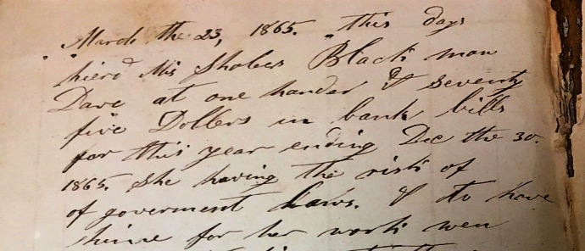
Fogle, Augustus. “A. Fogle Steward’s Account of Salem Female Academy 1865-1866.” Courtesy of Salem Academy & College Archives

Slide 6
Happy Hill, across the Salem Creek
African Moravian Church
“St. Philips Church – Lot 104,” Forsyth County Public Library Photograph Collection

Slide 7
Sanborn Fire Insurance Maps of Winston Salem, Forsyth Co., North Carolina, April 1895.
Lehman Hall, 2018
Lehman Hall, 1895
“Negro Ten’m’ts”
Map data ©2018 Google

Slide 8
“Crist Bottom,” Old Salem Museums & Gardens Photograph Collection

Slide 9
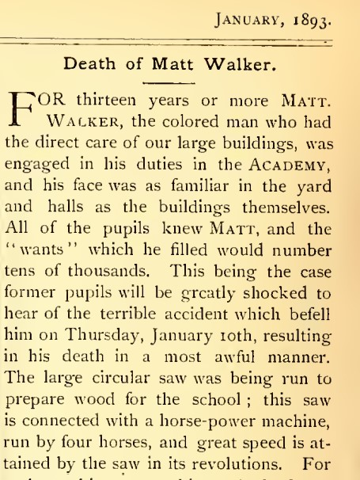
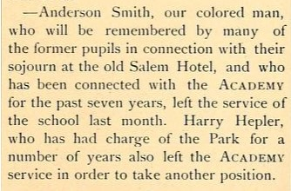
Matt Walker, 1893
Anderson Smith, 1891
“Chronicle and Gossip,” The Academy, 1891.
“Death of Matt Walker.” The Academy, 1893.

Slide 10
“Kitchen Staff at Salem College,” Old Salem Museums & Gardens Photograph Collection

Slide 11
Salem Academy & College Archives Photograph Collection

Slide 12
Acknowledgements
This presentation would not be possible without:
Terry Collins
Salem Academy & College Archives
Martha Hartley, Director of Research and Outreach
Old Salem Museums & Gardens
Dr. Daniel Prosterman

Slide 13
Works Cited
“Salem Female Academy,” North Carolina Room, Forsyth County Public Library Postcard Collection
Emancipation in Salem, the reading of General Orders No. 32. Pencil graphite drawing by Leo Rucker. Courtesy of Old Salem Museums & Gardens.
Ruger & Stoner, Madison, Wisconsin. “Bird’s Eye View of the Twin Cities, Winston-Salem, North Carolina, 1891.” Winston-Salem: Wachovia Historical Society Collection.
Salem Academy & College Archives Ledger Collection
Fogle, Augustus. “A. Fogle Steward’s Account of Salem Female Academy 1865-1866.” Courtesy of Salem Academy & College Archives
“St. Philips Church – Lot 104,” Forsyth County Public Library Photograph Collection
Map data ©2018 Google
Sanborn Fire Insurance Maps of Winston Salem, Forsyth Co., North Carolina, April 1895.
“Crist Bottom,” Old Salem Museums & Gardens Photograph Collection
“Kitchen Staff at Salem College,” Old Salem Museums & Gardens Photograph Collection
Salem Academy & College Archives Photograph Collection
“Chronicle and Gossip,” The Academy, 1891. https://library.digitalnc.org/cdm/singleitem/collection/yearbooks/id/7867/rec/2
“Death of Matt Walker.” The Academy, 1893. https://library.digitalnc.org/cdm/singleitem/collection/yearbooks/id/7867/rec/2

